Slide 1
Monitoring and dashboarding in ICP
Ingo Averdunk AVERDUNK@de.ibm.com
Raymond “Ray” Stoner rstoner@us.ibm.com

Slide 2
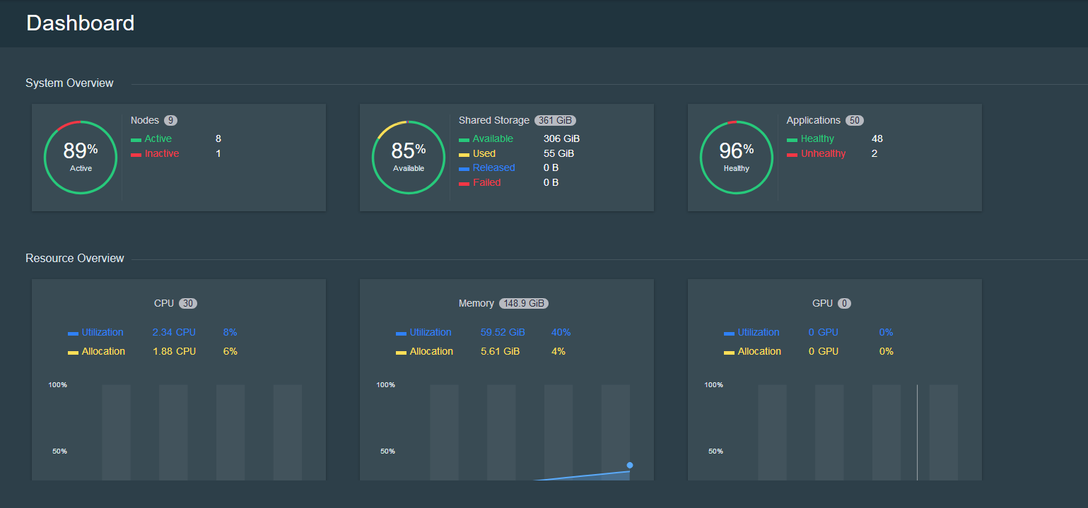
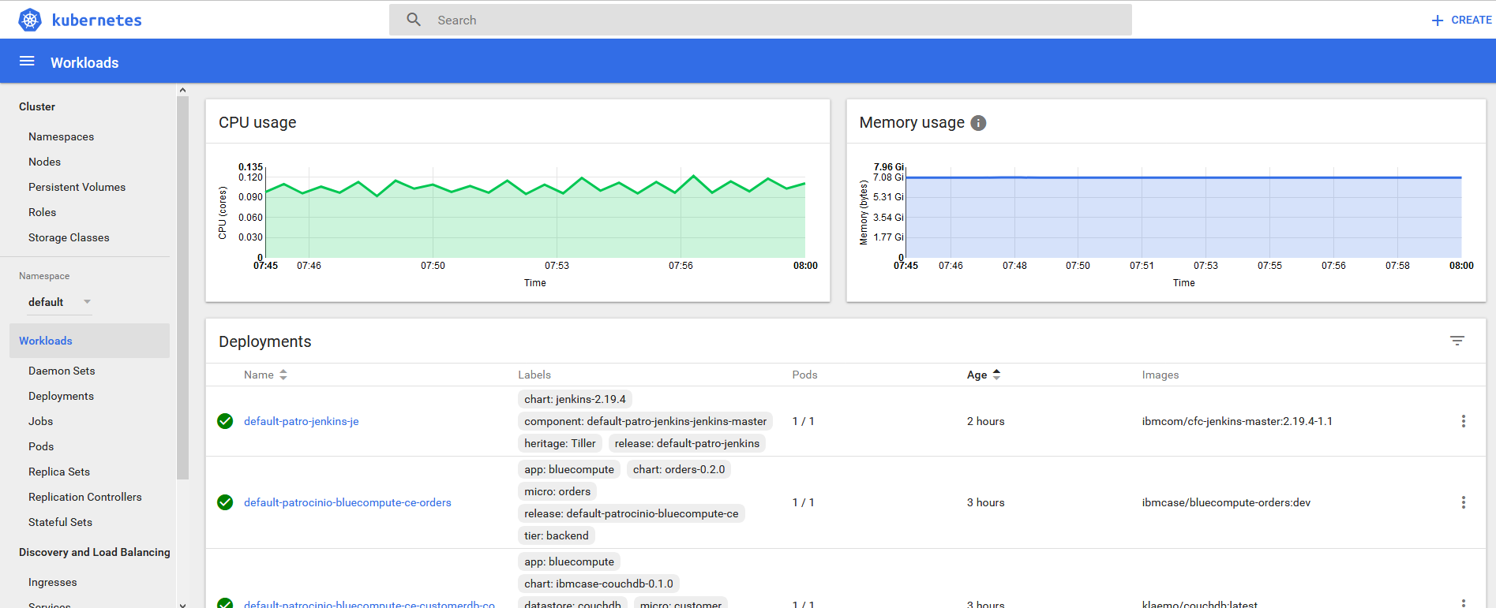
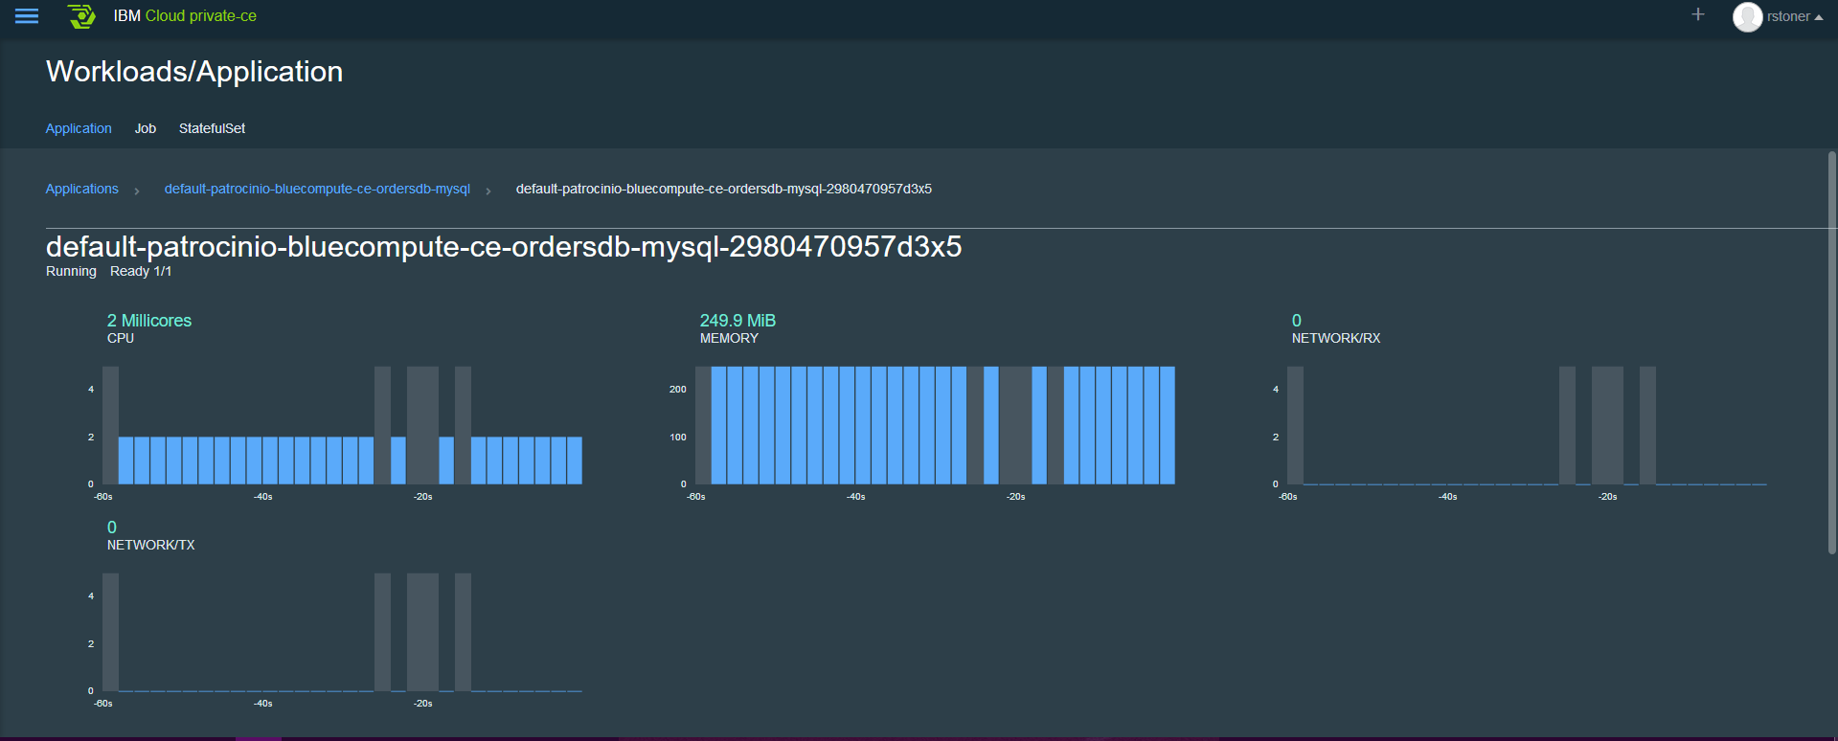
Monitoring an IBM Cloud Private Deployment
Within IBM Cloud Private there are several ways to view high level Key Performance Indicators
The ICP dashboard shows a high level overview of resource usage and status.
The Kubernetes Dashboard shows cpu and memory consumption of the full cluster and deployments
Within an application you can view performance of the pod.
We need to be able monitor and alert on Out of Bounds conditions for the applications and their infrastructure.

Slide 3
What is the base level of Monitoring/Logging in ICP?
In the October release, the ICP infrastructure and the two types of workloads will be monitored.
The ICP dashboard shows the status, metrics and log entries for all the workloads & Infrastructure.
An ELK stack collects logs from all the workloads & Infrastructure. Multiple ELK stacks are possible (but each log can only reside in one stack)
A Prometheus stack collects logs from the Kubernetes workload
Customizable Grafana and Kibana dashboards are available for use
Prometheus can send alerts to external system (email, webhooks)
Alerts
Extendable Dashboards and Alerts (Grafana/Kibana)
5
4
Default Dashboards
1
Prometheus
Kubernetes
ELK Stack
3
2
Heapster
Hosting Infrastructure (Virtual servers)

Slide 4
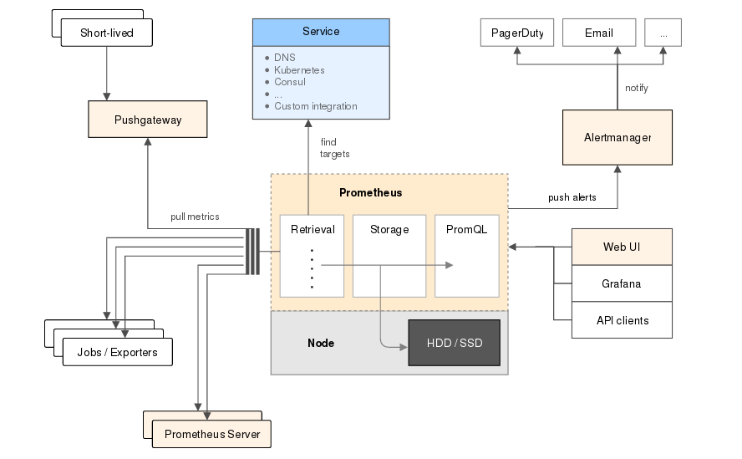
Prometheus
Prometheus is a Cloud Native Computing Foundation (CNCF) project, is a systems and service monitoring system. It collects metrics from configured targets at given intervals, evaluates rule expressions, displays the results, and can trigger alerts if some condition is observed to be true. https://prometheus.io/
Prometheus has several components for Time Series Data Collection, an Alert Manager and the Prometheus Server which scrapes and stores the data.

Slide 5
Grafana
Grafana is an open source metric analytics & visualization suite. It is most commonly used for visualizing time series data for infrastructure and application analytics but many use it in other domains including industrial sensors, home automation, weather, and process control.
https://grafana.com/grafana
While Prometheus has limited dashboarding capabilities of its own, regular display of metrics will be done using Grafana dashboards.
Prometheus and the Grafana Dashboards are installed togethers as applications into ICP

Slide 6
ELK stack or Elasticsearch Stack
The Elasticsearch stack (previously known as the ELK Stack) is a Log Management system which is composed of 3 layers:
Kibana is the extensible user interface for configuring and managing all aspects of the Elastic Stack.
Elasticsearch is a distributed, JSON-based search and analytics engine designed for horizontal scalability, maximum reliability, and easy management.
Logstash is a dynamic data collection pipeline with an extensible plugin ecosystem and strong Elasticsearch synergy.
Beats is a platform for lightweight shippers that send data from edge machines to Logstash and Elasticsearch.
Elasticseach is deployed automatically when ICP is installed (can be customized and/or opted-out of)

Slide 7
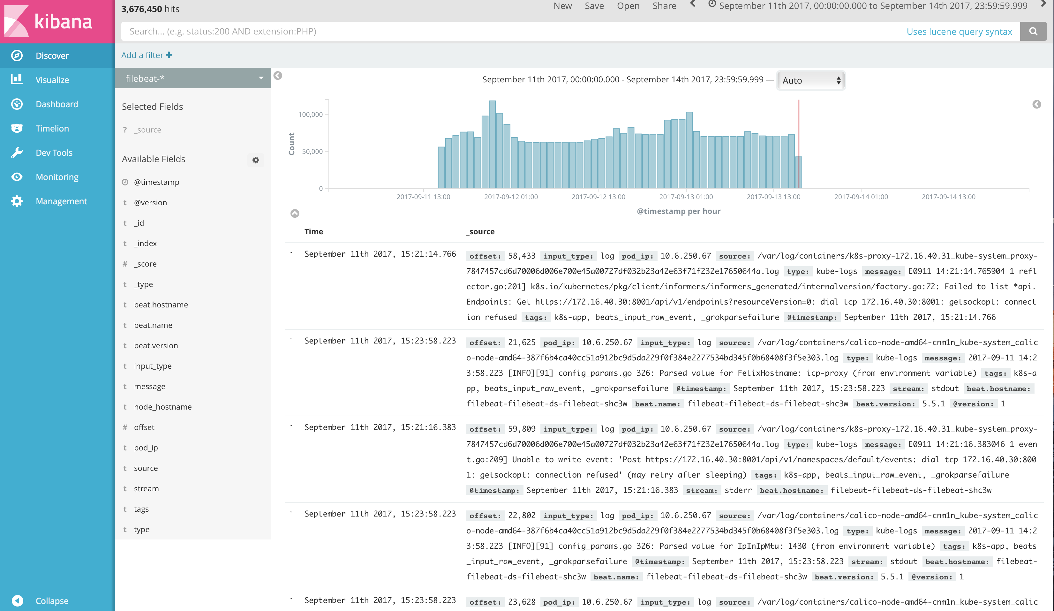
What are the advanced Logging capabilities for ICP? (Level 3)
External Elasticsearch / Log Analysis
Kubernetes
Default Elasticsearch Stack
Additional Elasticsearch Stack
Hosting Infrastructure (Virtual servers)

Slide 8
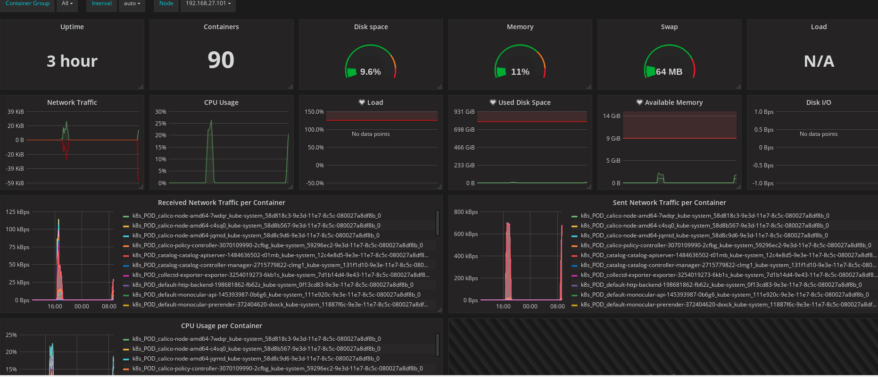
Custom Dashboards with Grafana
Pre-built dashboards are available here https://grafana.com/dashboards and can be imported to your Grafana application – the pre-built dashboards may require some “adjusting: for your environemtn.

Slide 9
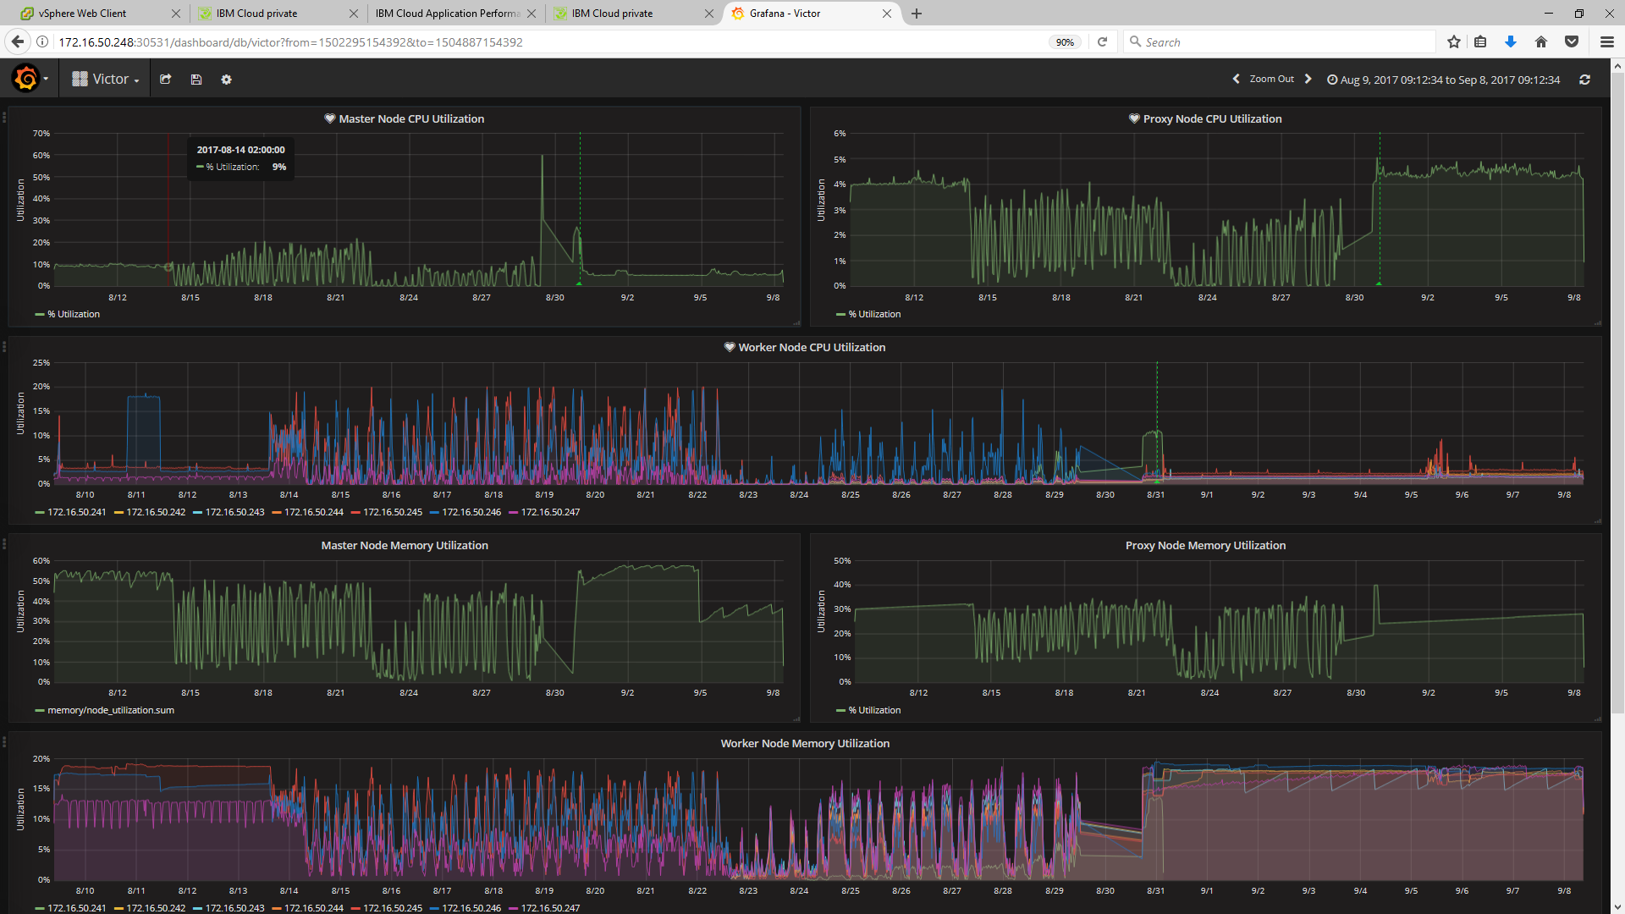
Custom Dashboards with Grafana
Victor, who is our Sight Reliability Engineer for CAMSE has built a custom dashboard for the ICP workload. Please see http://docs.grafana.org/guides/getting_started/ where you can quickly learn how to build custom dashboards.

Slide 10
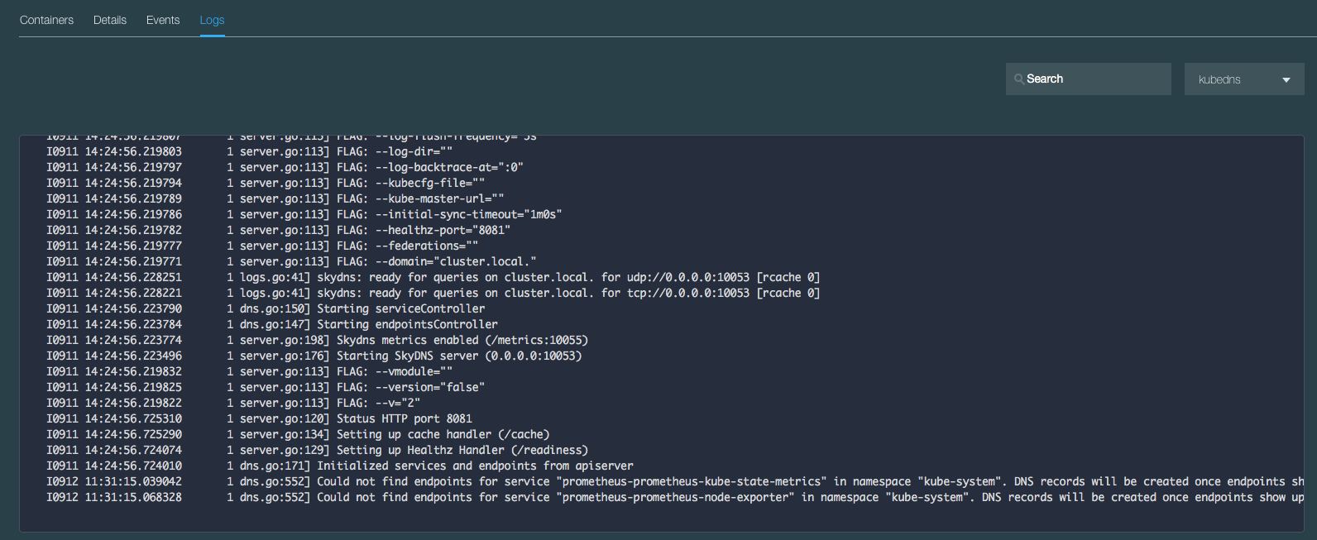
View Logs in Server UI
Example of looking at kube-dns logs:
In Server UI: Workloads → Applications
Select the application (eg. kube-dns) entry
In the lower section of the page
Select the application pod in the pod section
Scroll down and select the ‘Logs’ option

Slide 11

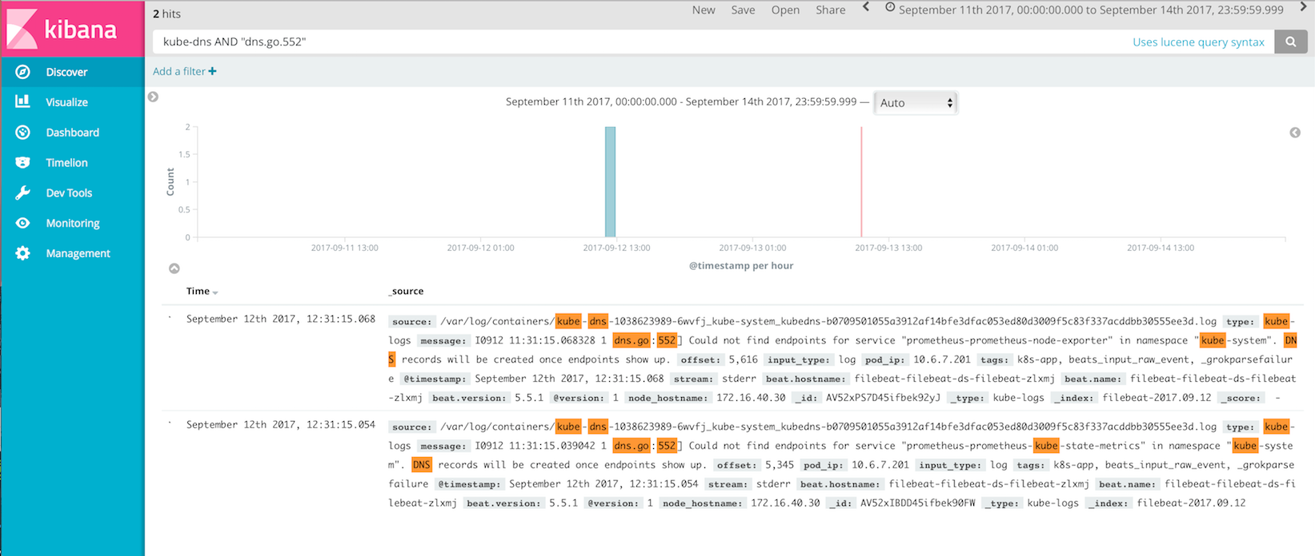
View Logs in Kibana
Use search filters to show log example entries shown in previous slide

Slide 12

Operations Transformation – Organizational Change
Traditional
Enterprise IT
Co-exist
Large Enterprise
Moving to Cloud
Small
Startup
Enterprise DevOps teams – delivering Microservices as full-stack deployments. Design tor resiliency, testing, QA.
Full Stack DevOps Team
Dev – app development, deploy, test…(note: QA team omitted to keep simple)
join
Ops – Services & middleware:
request driven provisioning,
configuration, patch..
Site Reliability Engineers / Environment Ops - Centralized policy, governance, audit.
Ensure org compliance policy, interface with cloud provider, First Responders, define acceptance criteria for new Microservices, and automated tests, audits, triage.
split
Ops – infrastructure: Procurement, provisioning, OS patch, etc.
Third party cloud provider (ex: IBM)
Third party cloud provider (ex: IBM)
Application
Services / Middleware
DevOps personas need a view of their project
SRE / Environment Ops personas need a view across multiple DevOps teams
Traditional IT Ops needs view across both traditional and cloud environments
Infrastructure

Slide 13
Operations Transformation – Relationship of CSMO and DevOps
ITIL ?
SRE
aaS
DevOps
Development
IT Operations
EnvOps
Cloud Service Management and Operations (CSMO)
DevOps
Environment Ops
Service Management,
ITIL, IT4IT, ZeroOutage
Site Reliability
Engineering

Slide 14
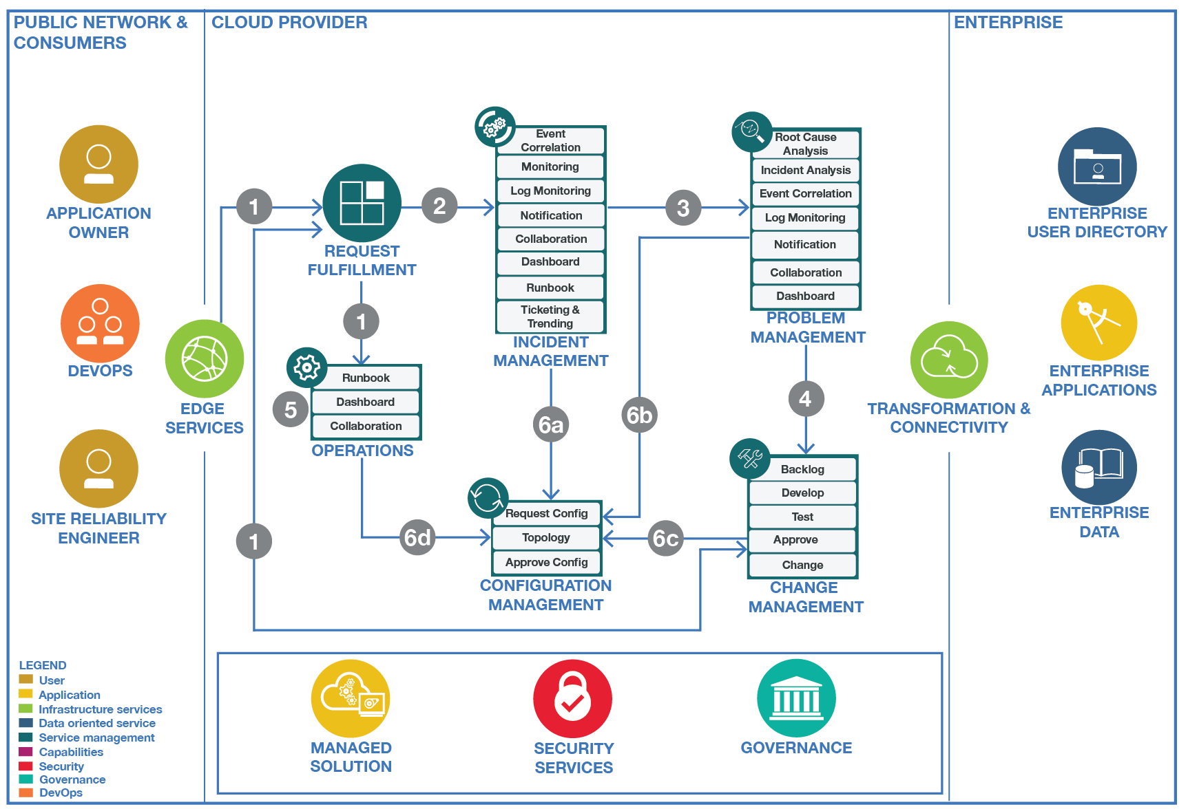
Cloud Service Management and Operation

Slide 15
Incident Management Tool Chain
IBM
3rd Party
Dashboards & Reporting
DASH
Grafana
Monitoring
Runbooks
Prometheus
RBA
Cloud Monitoring
BAM
Event
Management
Notification
Collaboration
APM
Slack
NOI
ANS
Logging
Ticketing & Trending
Elasticsearch
Log Analysis
ICD
Monitor
Analyze
Plan
Execute
15

Slide 16
Build To Manage – How to build manageable applications
As Development and Operations come closer together, new practices arise to better enable operations for cloud-based applications.
Shift Left: Build manageable applications / micro-services
Practices Include
HealthCheck API
Metrics
Deployment Correlation
Topology Information
Log Format and Catalog
Distributed Tracing
Event Format and Catalog
Monitoring Configuration
First Failure Data Capture
Test Cases and Scripts
Runbooks
Documentation
manageability
management
Health API
Runbook
Events
Logs
Application / Micro Service
(Managed entity)
Manageability defines how managed entities communicate with management functions
Management Tool
Management System
Application-specific Management Instrumentation
Component of the Management Stack

Slide 17
Backup slides

Slide 18
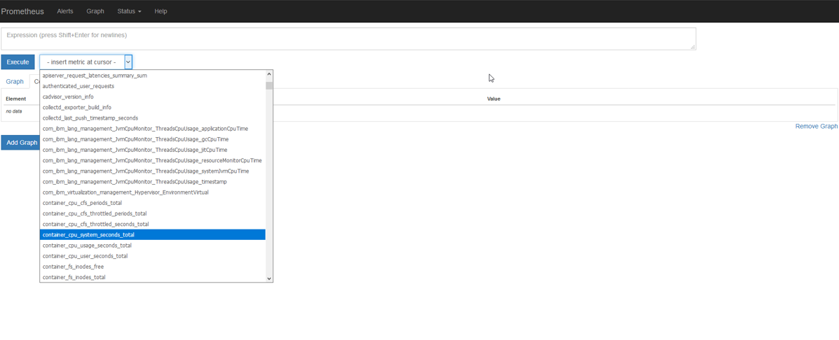
Prometheus Demo
Perform a query against the time series data, using the dropdown select the metric you would like to query, this example is using container_cpu_system_seconds total. Once the metric is selected, click on Execute to run the Query. You may also perform custom queries using the Expression area at the top of the screen.

Slide 19
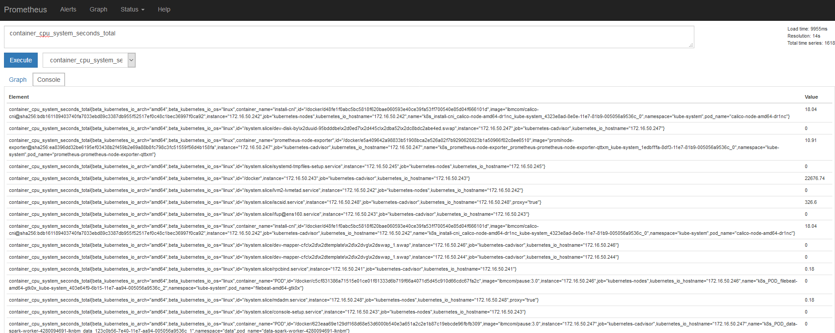
Prometheus Demo
The query results are then displayed on your console view:

Slide 20
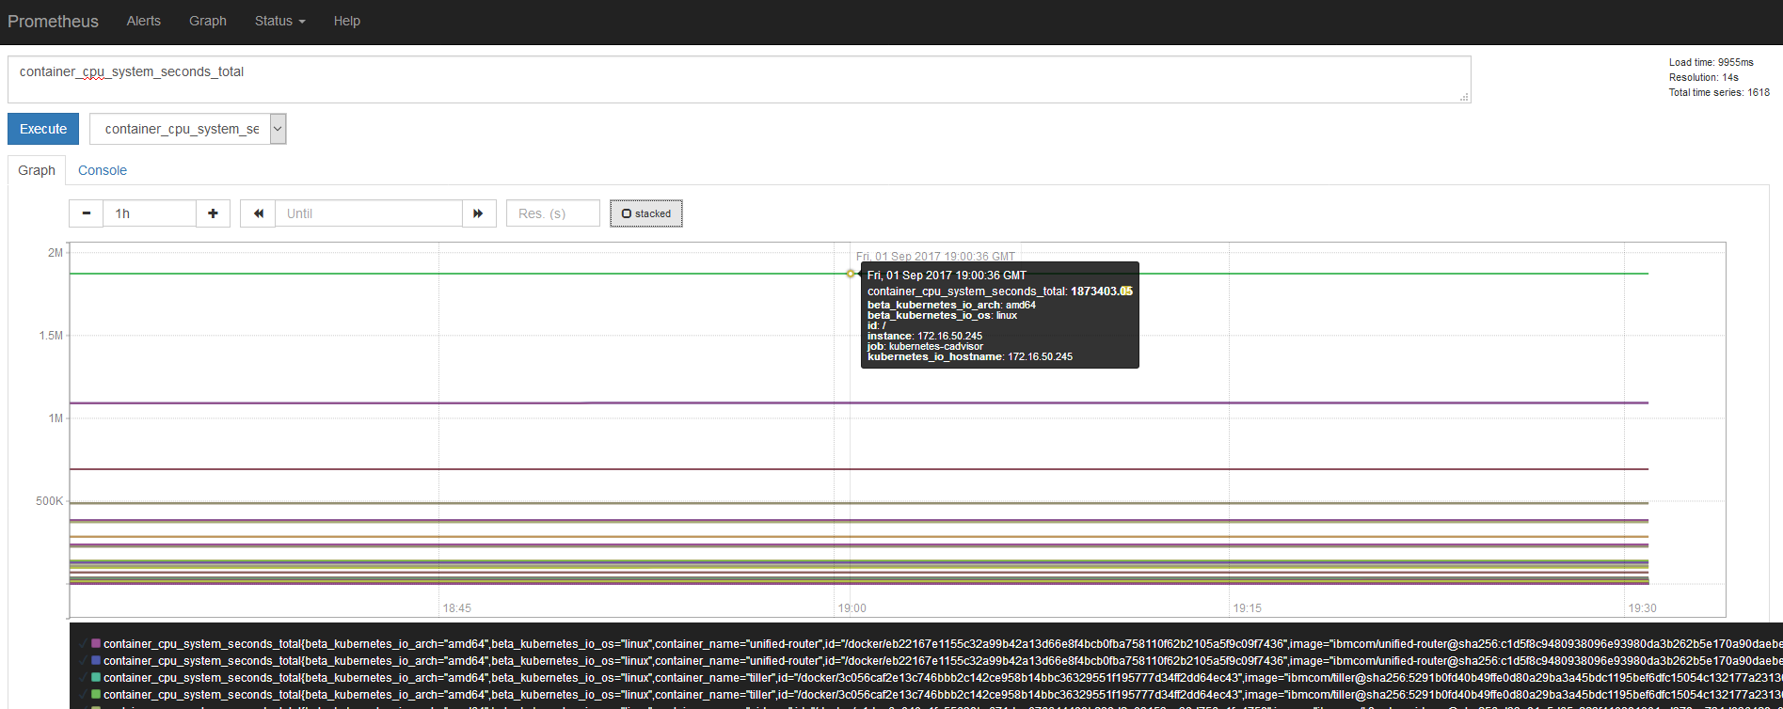
Prometheus Demo
Click the Graph button to graph the total cpu seconds:

Slide 21
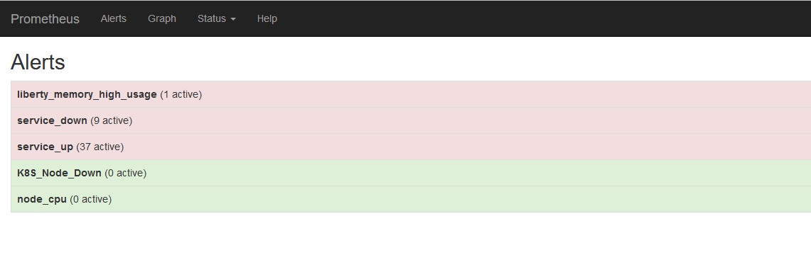
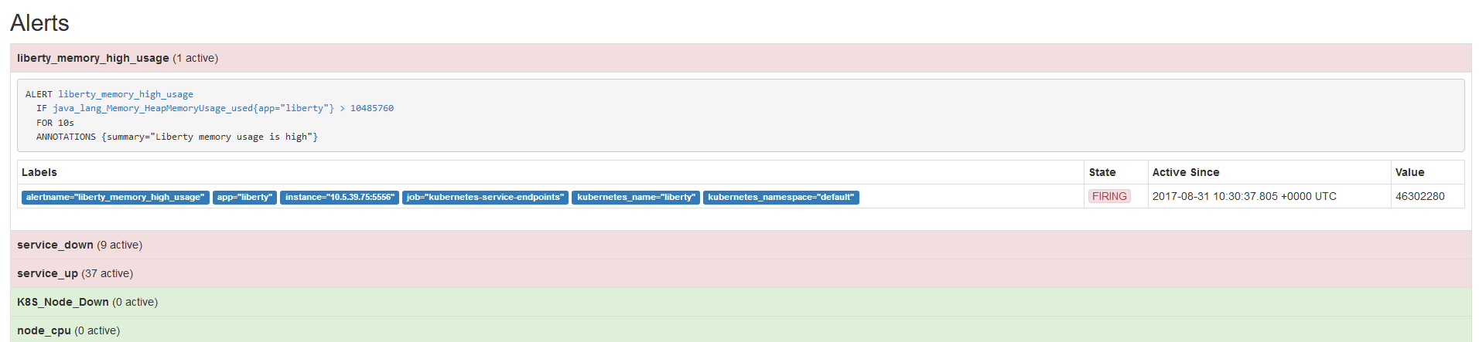
Prometheus Demo
There is an Alert summary view which displays a high level summary of open alerts:
Click on the alert group to see more information

Slide 22
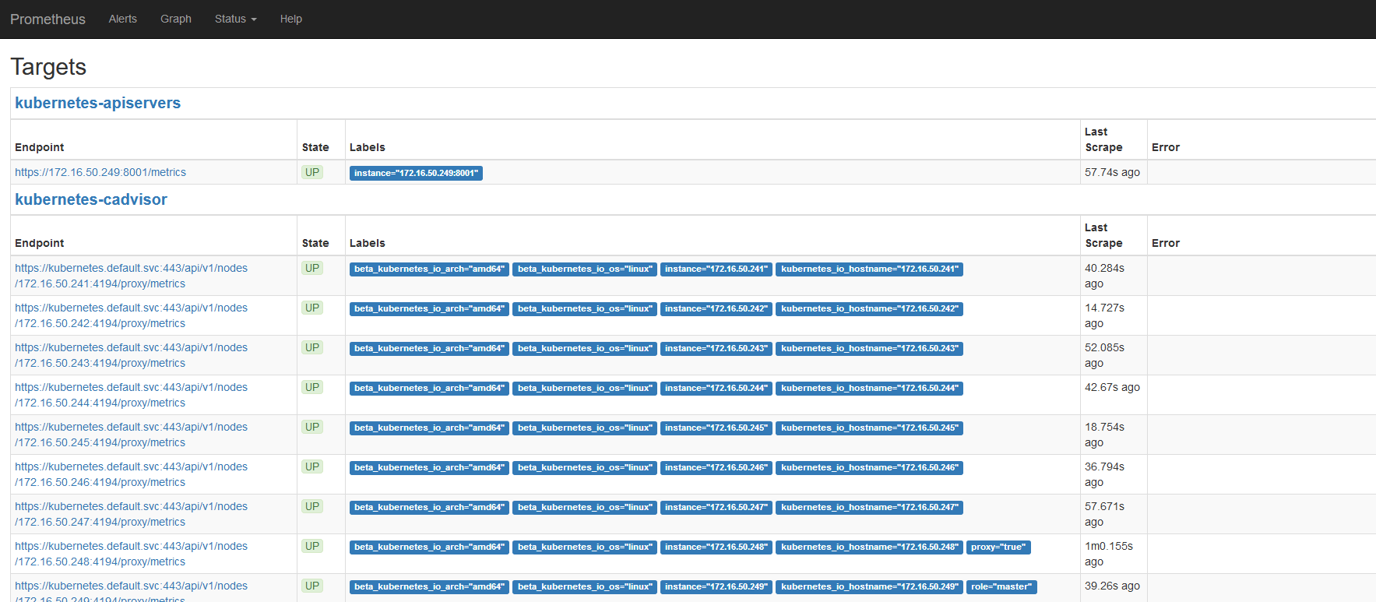
Prometheus Demo
A useful status is the Targets view, where you can see all the items that Prometheus is monitoring:

Slide 23
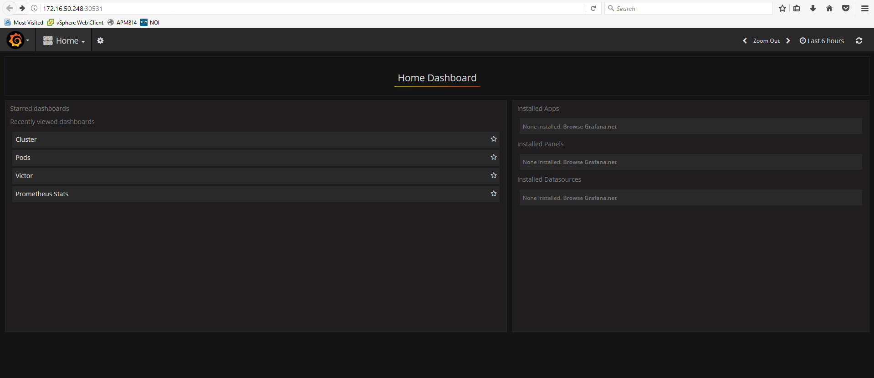
Grafana Demo
Grafana – Using Grafana provides to ability to view and leverage the data collected by Prometheus.

Slide 24
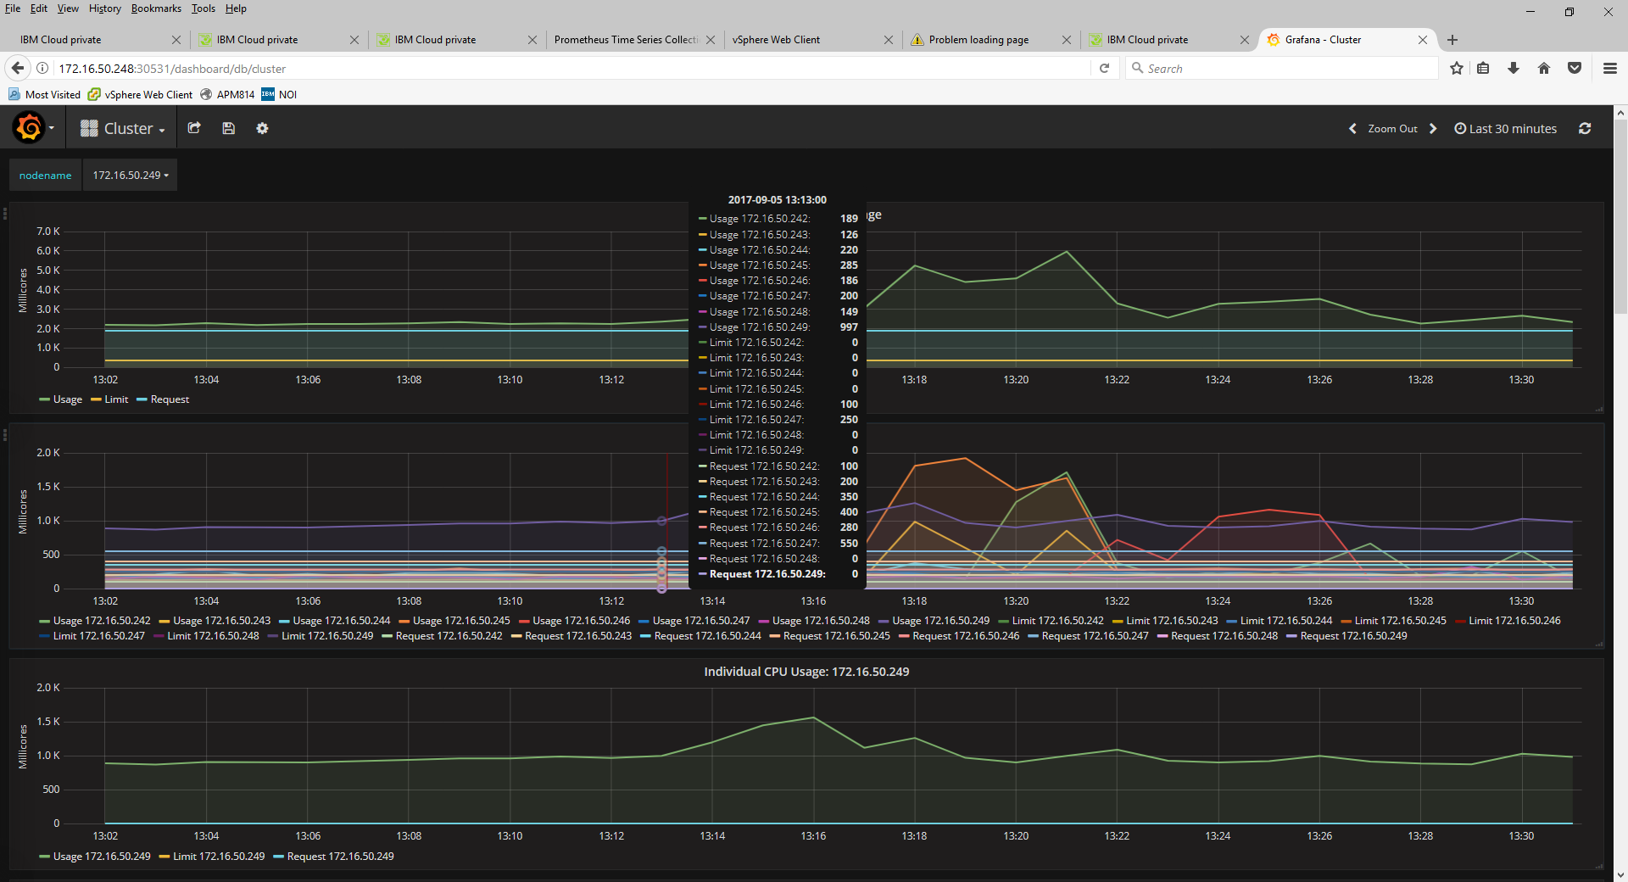
Grafana Demo
Below is the cluster view of the ICP deployment

Slide 25
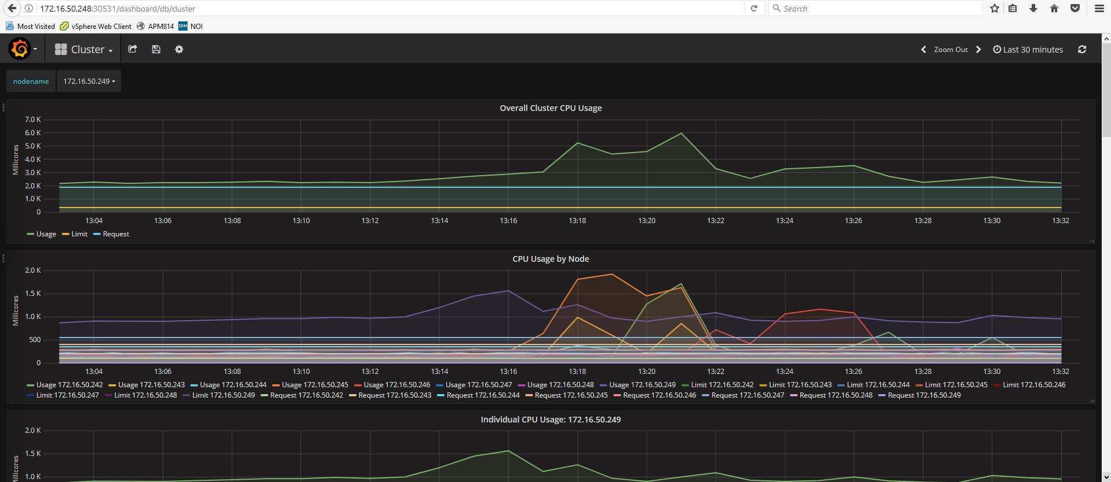
Grafana Demo
Below is the cluster view of the ICP deployment

Slide 26
Grafana Demo
Using your mouse to scroll over a view - a legend is provided with the cluster IP address an the metric value
Notes:
This top level view is quite “lengthy” be sure to scroll down to display the remaining metrics

Slide 27
Custom Dashboards with Grafana
Victor who is our Site Reliability Engineer for CAMSE has built a custom dashboard for the ICP workload.

Slide 28
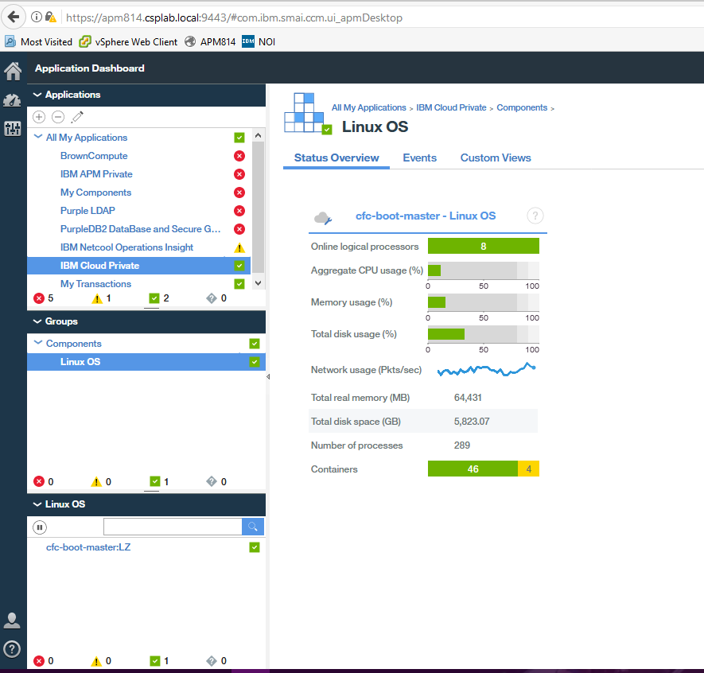
IBM Cloud private Performance Monitoring
Using IBMs APM to solution monitor resources in Icp
Existing IBM APM v8 customer can leverage the OS agent to monitor resource consumption of the ICP deployment.
No special configuration is required other then deploying ICP in an OS which is also supported by the OS Agent.
On the right is a high level summary view
of the OS agent

Slide 29
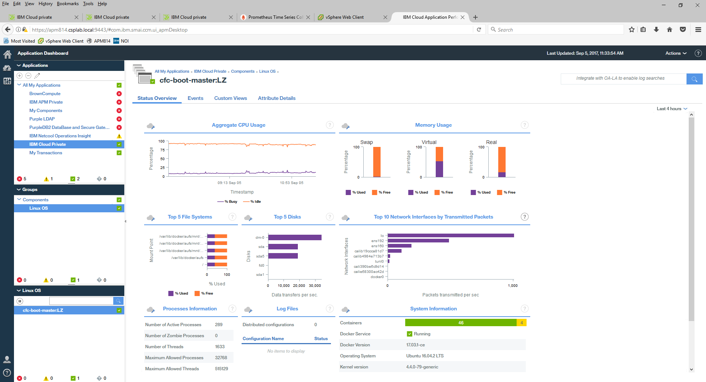
IBM Cloud private Performance Monitoring
Drill down into to OS agent, click anywhere within the status view, the lower right displays a summary of the containers running in the OS

Slide 30
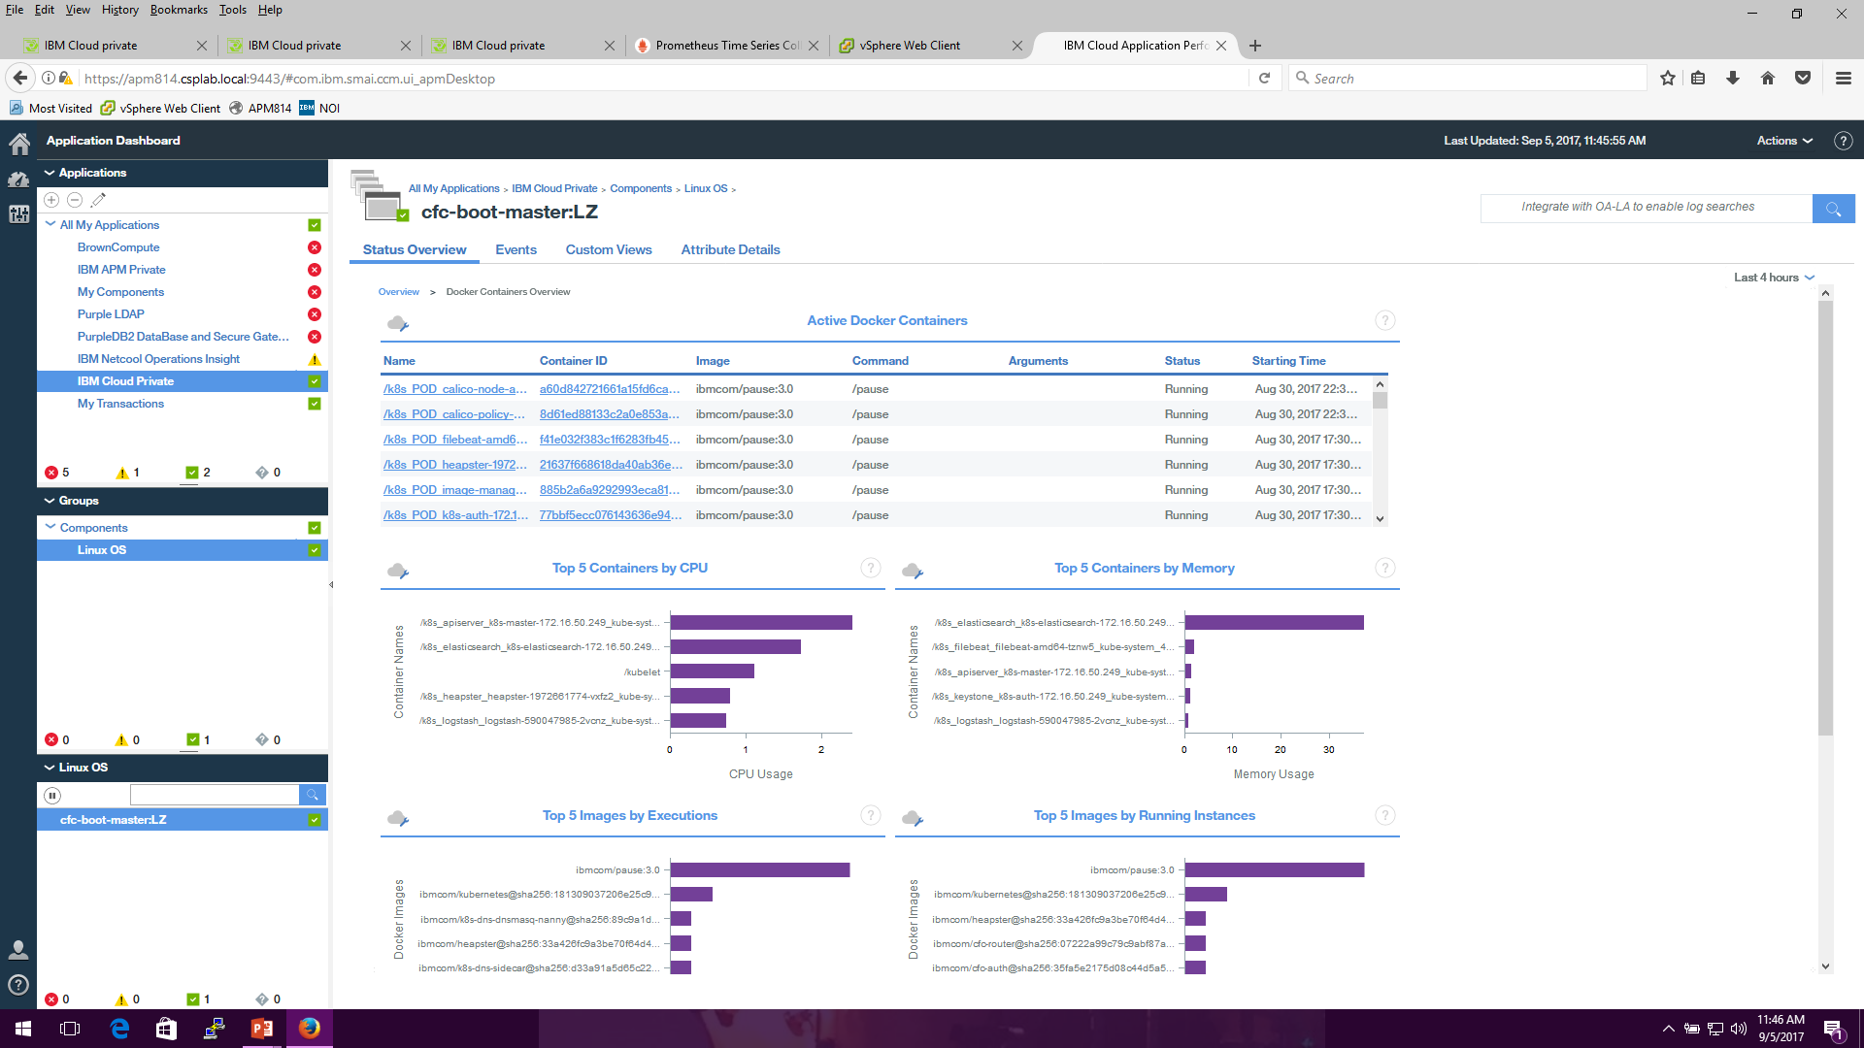
IBM Cloud private Performance Monitoring
Drill down into to a summary view of the containers , click anywhere within the System Information view
Notes:
Active Container View is sortabale by container id, command etc.

Slide 31
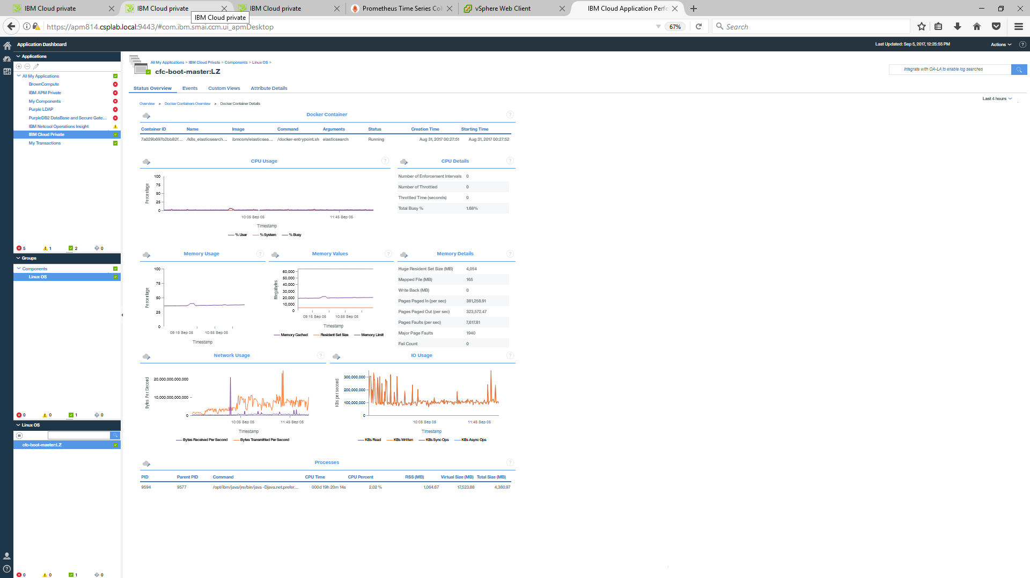
IBM Cloud private Performance Monitoring
Drill down to an individual container by clicking on the container in the active container view
Notes:
Here is view of the

Slide 32
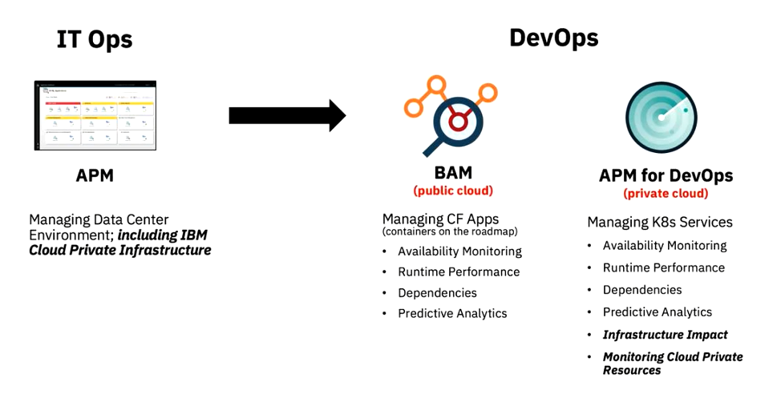

Slide 33
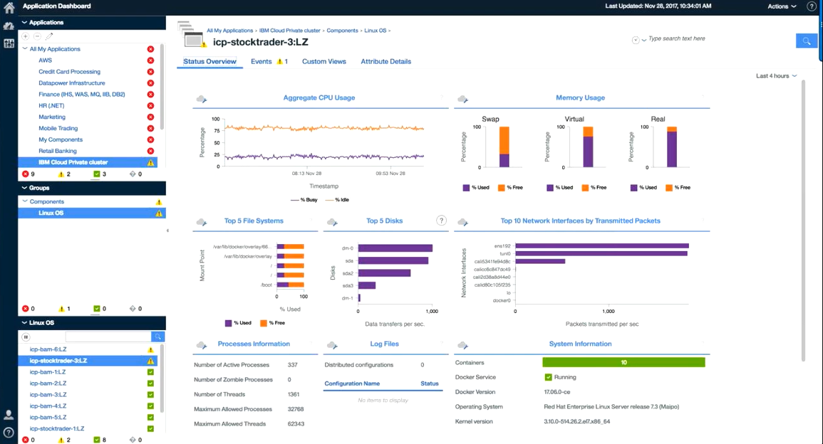

Slide 34
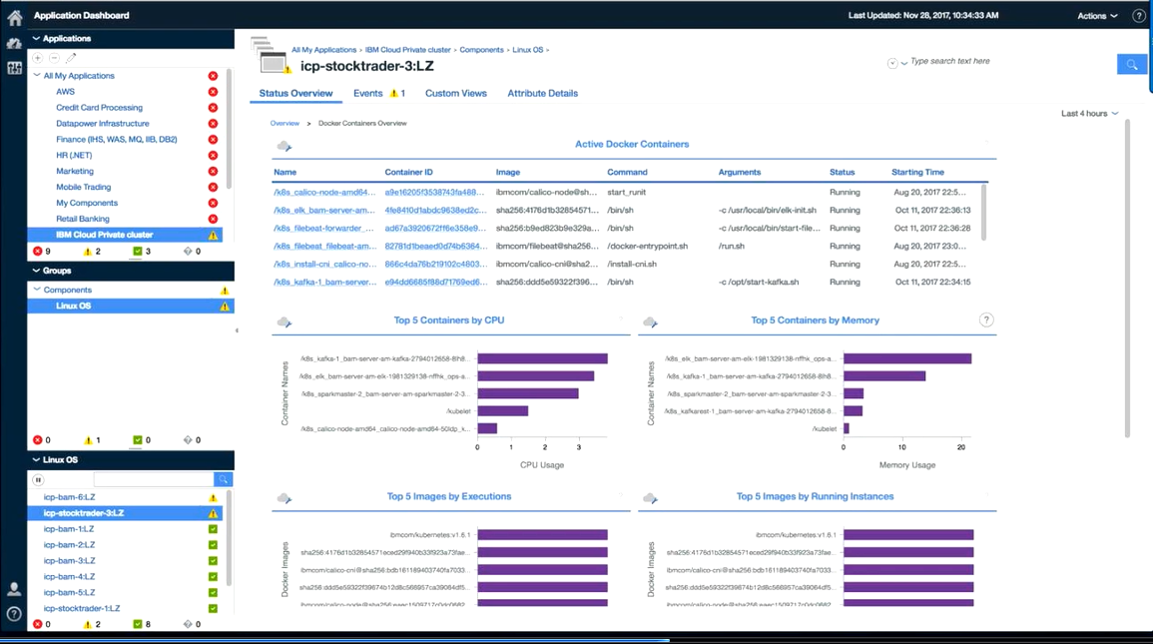

Slide 35
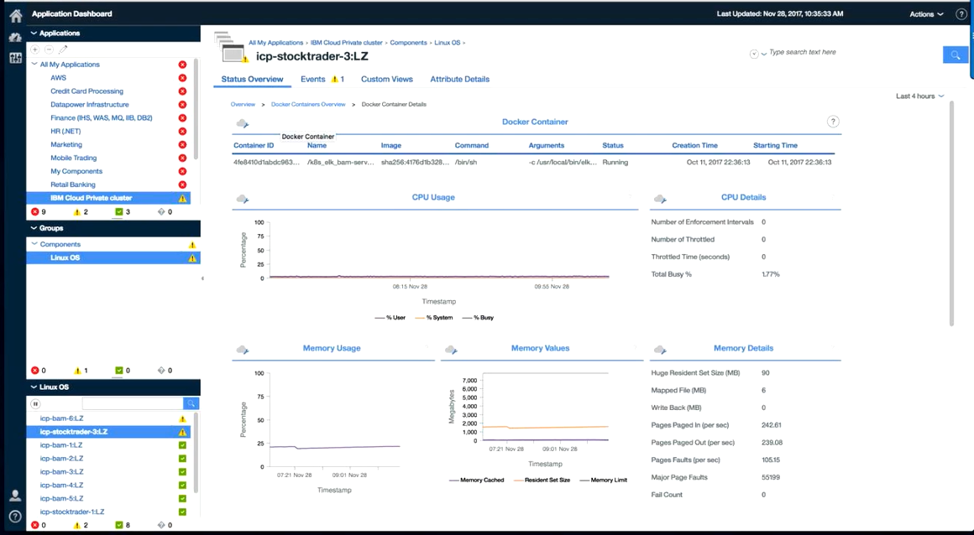

Slide 36
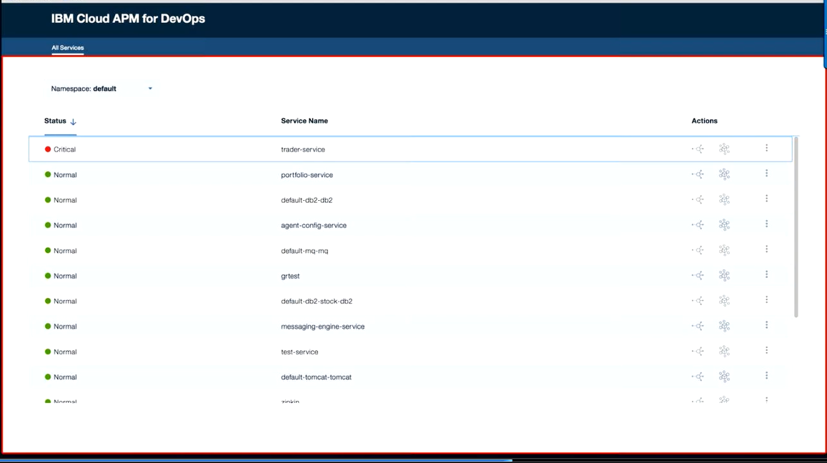

Slide 37
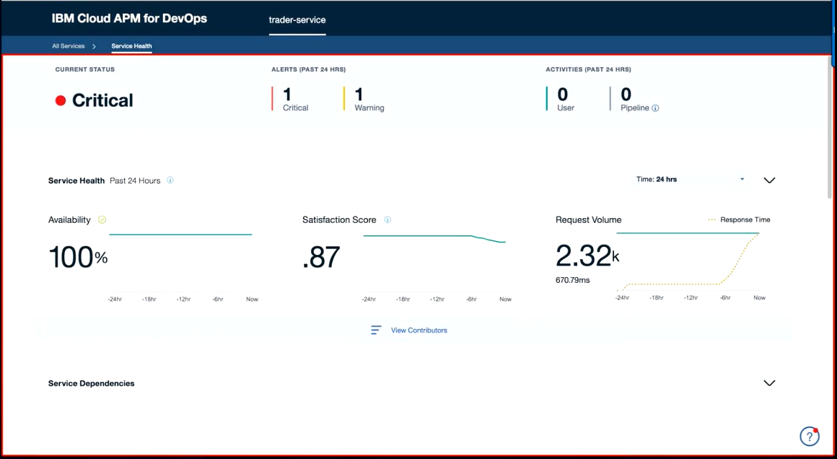

Slide 38
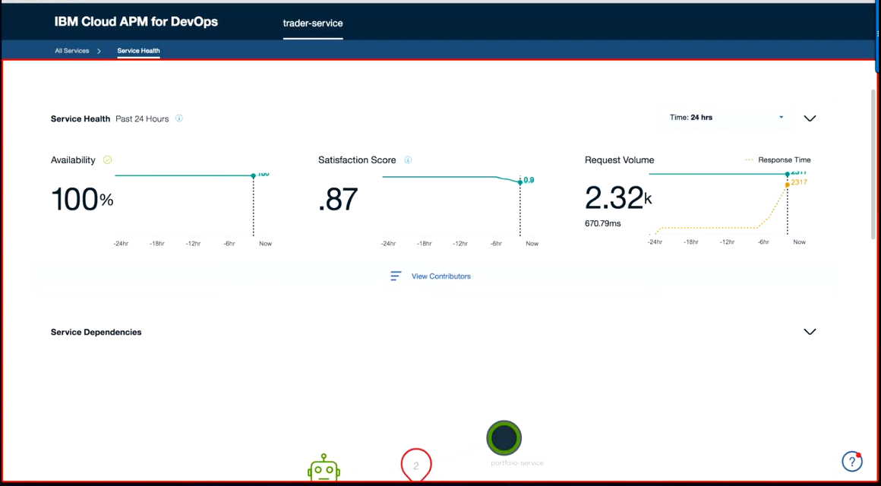

Slide 39
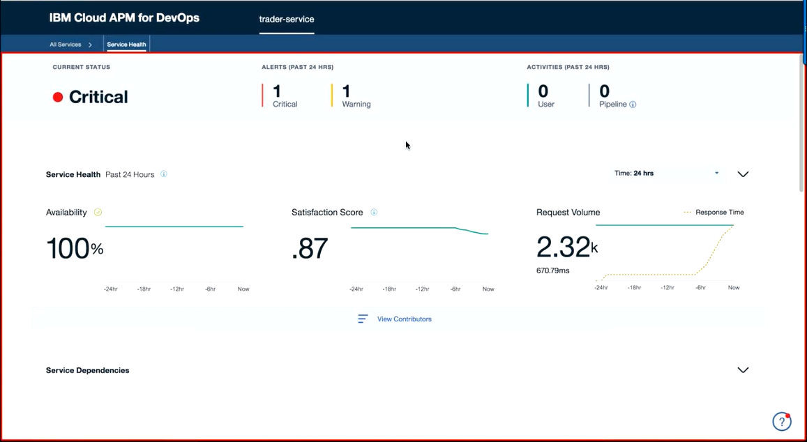

Slide 40
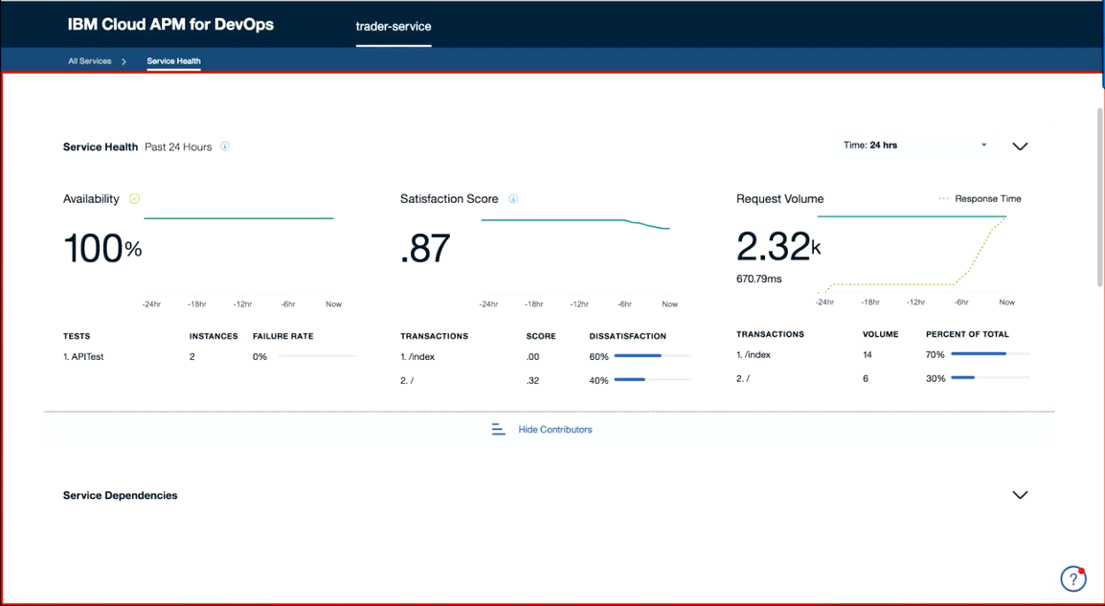

Slide 41
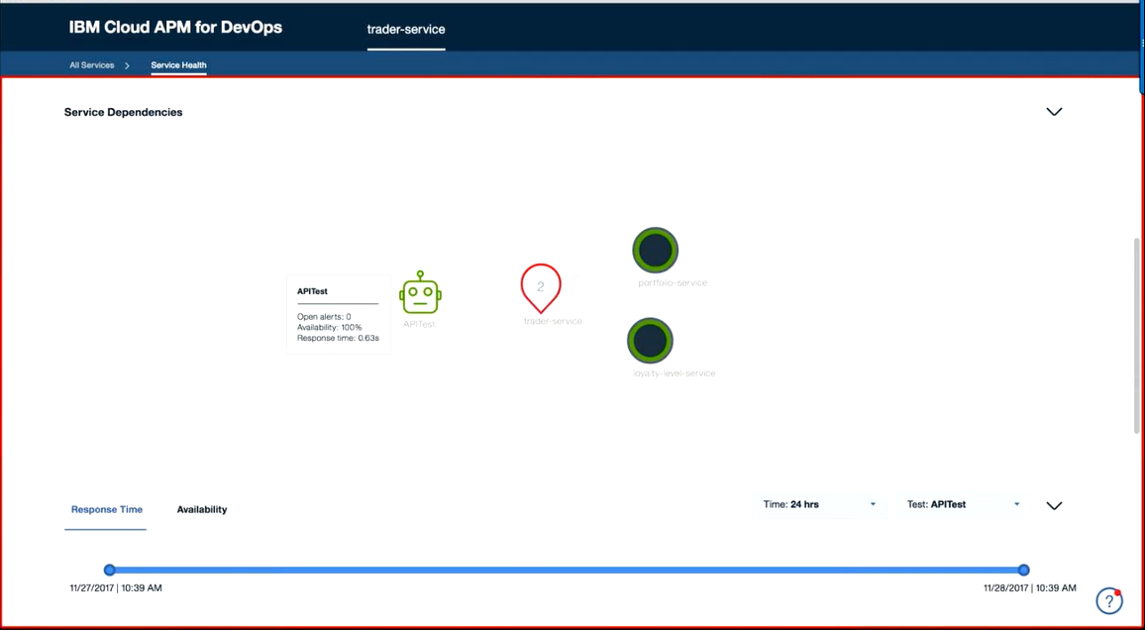

Slide 42
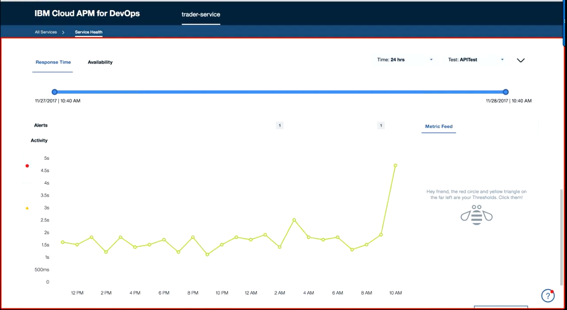

Slide 43
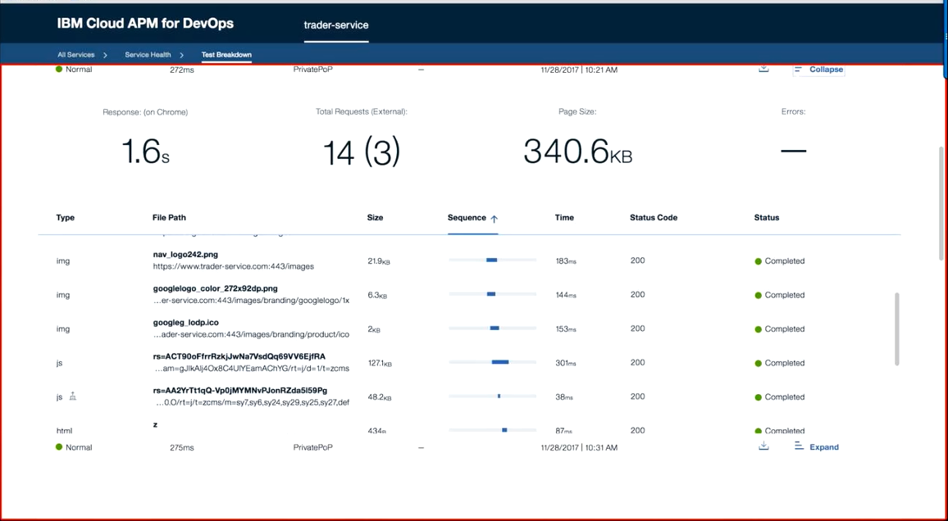

Slide 44
